Slide 1
Counting Techniques, Permutation & Combination

Slide 2
Counting Rules
Sample space of throwing 3 dice has 216 entries, sample space of throwing 4 dice has 1296 entries, …
At some point, we have to stop listing and start thinking …
We need some counting rules

Slide 3


The mn Rule
If an experiment is performed in two stages, with m ways to accomplish the first stage and n ways to accomplish the second stage, then there are mn ways to accomplish the experiment.
This rule is easily extended to k stages, with the number of ways equal to
  n₁ n₂ n₃ … n_{k}
Example: Toss two coins. The total number of simple events is:
2 × 2 = 4

Slide 4


Examples
m
Example: Toss three coins. The total number of simple events is:
m
2 × 2 × 2 = 8
Example: Toss two dice. The total number of simple events is:
6 × 6 = 36
Example: Toss three dice. The total number of simple events is:
6 × 6 × 6 = 216
Example: Two Marbles are drawn from a dish containing two red and two blue marbles. The total number of simple events is:
4 × 3 = 12

Slide 5

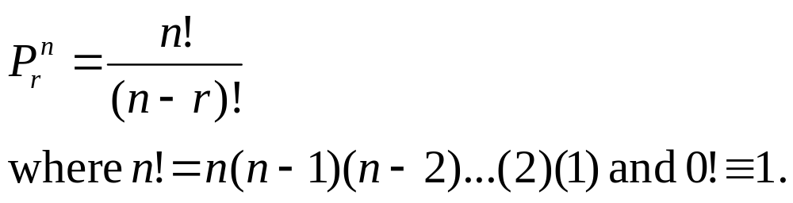
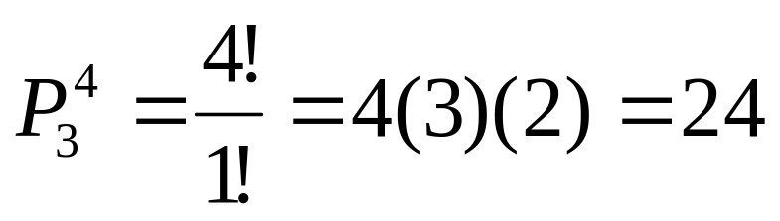
Permutations
The number of ways you can arrange
n distinct objects, taking them r at a time is
Example: How many 3-digit lock combinations can we make from the numbers 1, 2, 3, and 4?
The order of the choice is important!

Slide 6
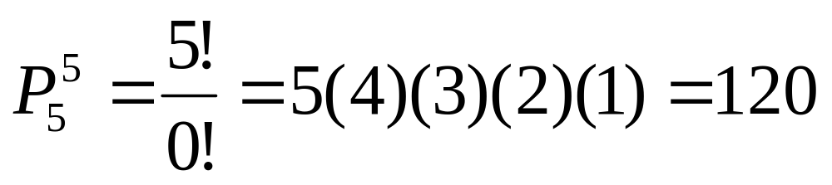
Examples
Example: A lock consists of five parts and can be assembled in any order. A quality control engineer wants to test each order for efficiency of assembly. How many orders are there?
The order of the choice is important!

Slide 7
Rules of Permutations
Number of permutation of n objects is n!
The number of permutations of n objects arranged in a circle is (n-1)!
The number of permutations of n things of which n₁ are of one kind, n₂ are of second…and so on (n!)/(n₁! n₂!....n_{k}!)

Slide 8
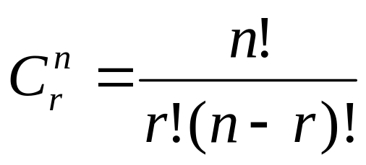
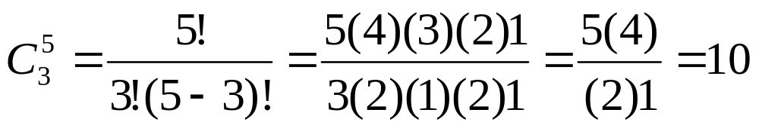
Combinations
The number of distinct combinations of n distinct objects that can be formed, taking them r at a time is
Example: Three members of a 5-person committee must be chosen to form a subcommittee. How many different subcommittees could be formed?
The order of
the choice is
not important!

Slide 9
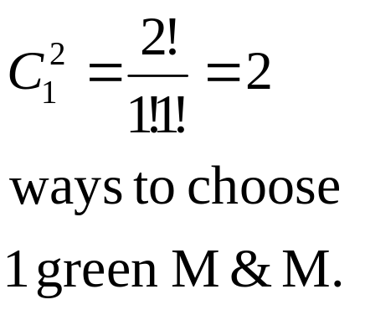
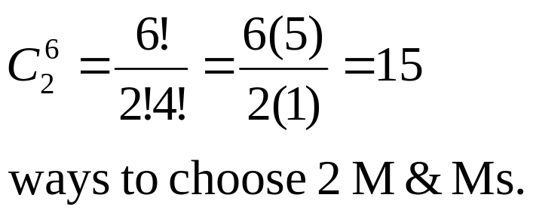
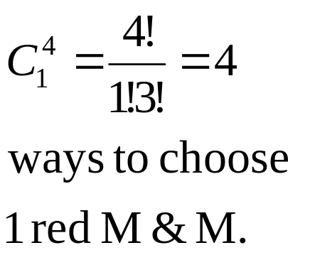
Example
m
m
m
m
m
m
A box contains six Marbles, four red
and two green. A child selects two Marbles at random. What is the probability that exactly one is red?
The order of
the choice is
not important!
4 × 2 =8 ways to choose 1 red and 1 green M&M.
P(exactly one red) = 8/15

Slide 10


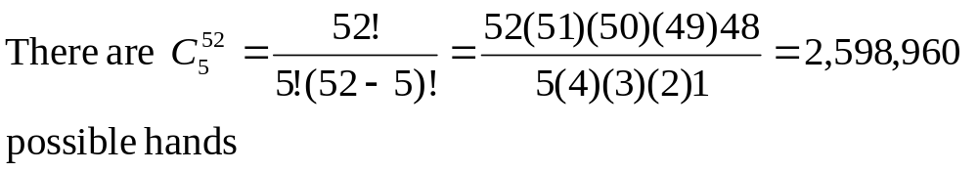
Example
A deck of cards consists of 52 cards, 13 "kinds" each of four suits (spades, hearts, diamonds, and clubs). The 13 kinds are Ace (A), 2, 3, 4, 5, 6, 7, 8, 9, 10, Jack (J), Queen (Q), King (K). In many poker games, each player is dealt five cards from a well shuffled deck.

Slide 11
Example
Four of a kind: 4 of the 5 cards are the same “kind”. What is the probability of getting four of a kind in a five card hand?
There are 13 possible choices for the kind of which to have four, and 52-4=48 choices for the fifth card. Once the kind has been specified, the four are completely determined: you need all four cards of that kind. Thus there are 13×48=624 ways to get four of a kind.
The probability=624/2598960=.000240096
and

Slide 12
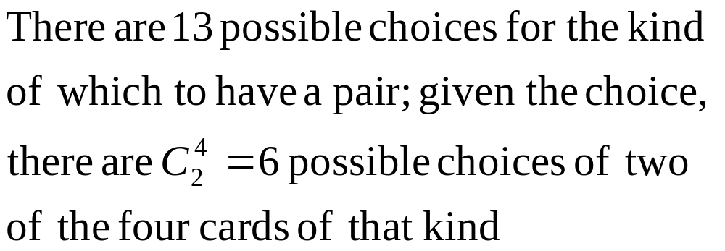
Example
One pair: two of the cards are of one kind, the other three are of three different kinds.
What is the probability of getting one pair in a five card hand?

Slide 13
Example
There are 12 kinds remaining from which to select the other three cards in the hand. We must insist that the kinds be different from each other and from the kind of which we have a pair, or we could end up with a second pair, three or four of a kind, or a full house.

Slide 14
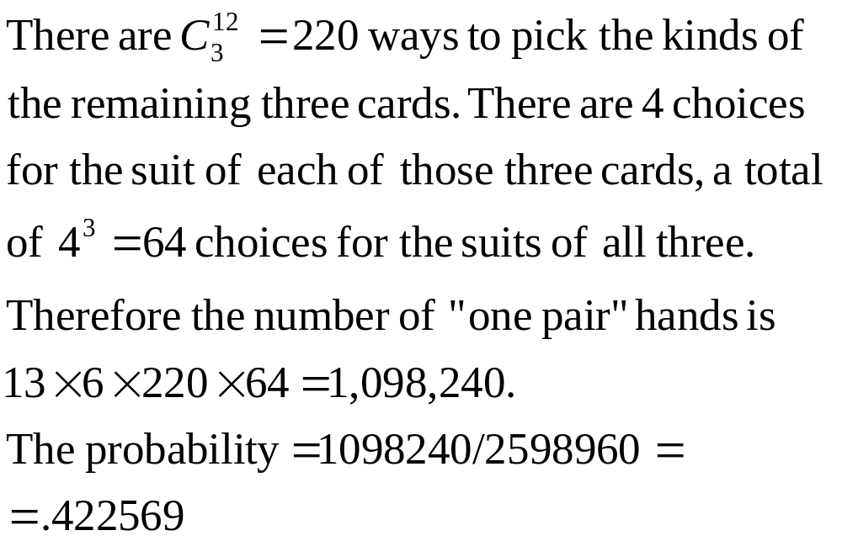
Example

